Slide 1






Surgical Activity Recognition in the Operating Room using RGBD Cameras
Emre Ozan Alkan
University of Burgundy
Supervisors:
Andru Putra Twinanda
Dr. Nicolas Padoy
Research Group CAMMA
Computational Analysis and Modeling of Medical Activities
Jun 15th, 2015
Notes:
Merhaba, Hello, Bonjour, Hola, ciao, здравствуйте.
My name is Emre Ozan Alkan. I’m MSCV student from University of Burgundy, 5th promotion.
I did my master thesis in Research Group Camma in Icube laboratoire in Strasbourg.
Our reasearch team is collobrating with the hospital of university of strasbourg to use their facilities.
Today I’m going to present you how we recognize surgical activities from an operating room with proposing a voting scheme.

Slide 2
Overview
Introduction
Related work
Methodology
Experiments
Conclusions
Notes:
Introduction: Why ? Motivation ? Challenges ?
Related work: Couple of work – motivates and underlies in our work
Methodology: Adopted pipeline and ourp ipeline and giving details about the classification models that we use
Experiments: I will show our experimental setup and results
Conclusions: In conclusions part: I will give summary&conlcusions, discussions and future work

Slide 3
Introduction
Context-aware systems in the operating rooms (OR) are important research topic
Activity recognition is a very important part of the context-aware systems
Wide applications
OR time management for hospitals
Automatic transcription of medical procedures
Surgical work-flow modeling and monitoring
We work on specifically activity recognition in OR using multi-view RGB-D cameras
Generic activities
Vertebroplasty-specific activities
Notes:
CAMMA: Computational Analysis and Modeling of Medical Activities
App: Modeling and recognizing staff activities
App: Correlation with x-ray radiation exposure
Vertebroplasty: Stabilize the spinal fracture to stop the pain. Considered a minimally invasive surgical procedure because of small puncture
Challenges: are not easy, very cluttered and dynamic environment, body tracking not working, only intensity videos or depth videos not sufficient due to specific type of actions of operations. hard to position cameras for best view, camera interference and many

Slide 4
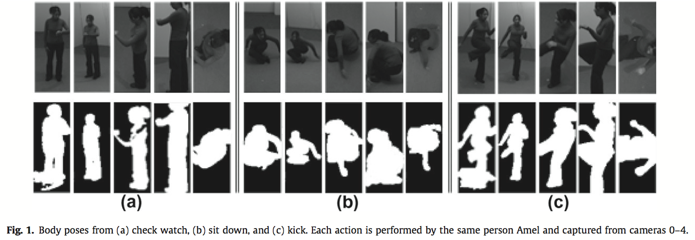
Related Work
Multi-view action recognition using local similarity random forests and sensor fusion [1]
[1] Fan Zhu, Ling Shao, Mingxiu Lin. Multi-view action recognition using local similarity random forests and sensor fusion. Pattern Recognition Letters archive Volume 34 Issue 1, January, 2013 Pages 20-24
Notes:
IXMAS dataset from INRIA, 5 views, 13 motions, 11 actors
Dataset has extracted silhouette from detected bounding box for humans.
So their method highly depend on the silhouette from all the views, which is hard to depend in real life scenarios
Extracted images are binary.

Slide 5
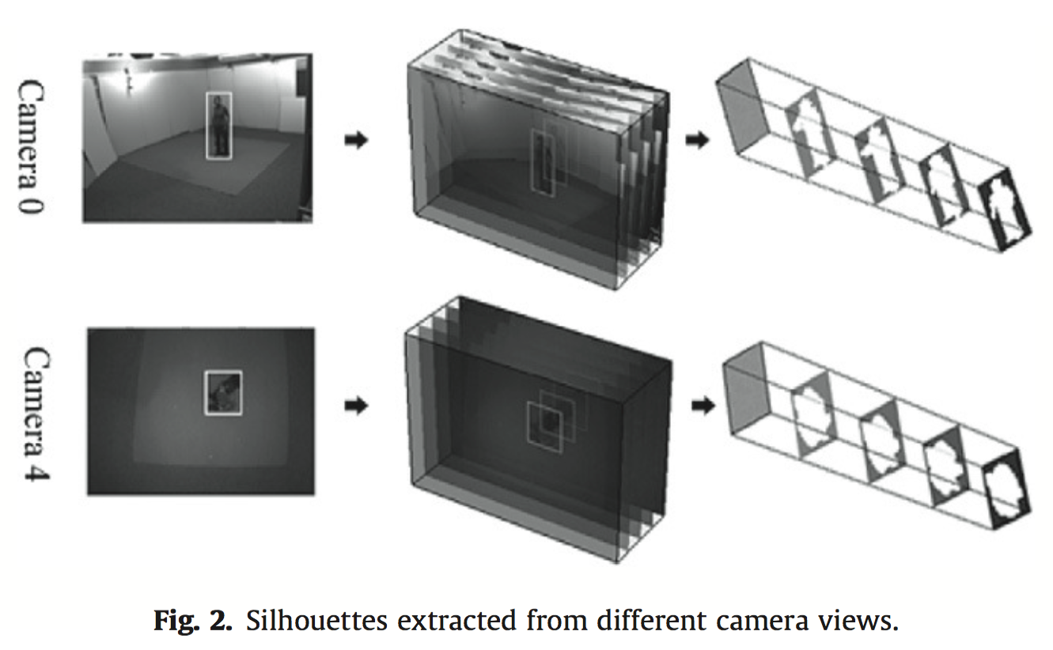
Related Work
Multi-view action recognition using local similarity random forests and sensor fusion [1]
[1] Fan Zhu, Ling Shao, Mingxiu Lin. Multi-view action recognition using local similarity random forests and sensor fusion. Pattern Recognition Letters archive Volume 34 Issue 1, January, 2013 Pages 20-24
Notes:
They divide videos into smaller videos. They call each frame in smaller video as segment. For each segment - which are binary images – they concatenate their rows and generate big feature vector for classification. This work is related because of using multi-view and introducing voting scheme – which is different then our voting scheme. In their voting scheme, each segment – frames, are voting for the action.

Slide 6
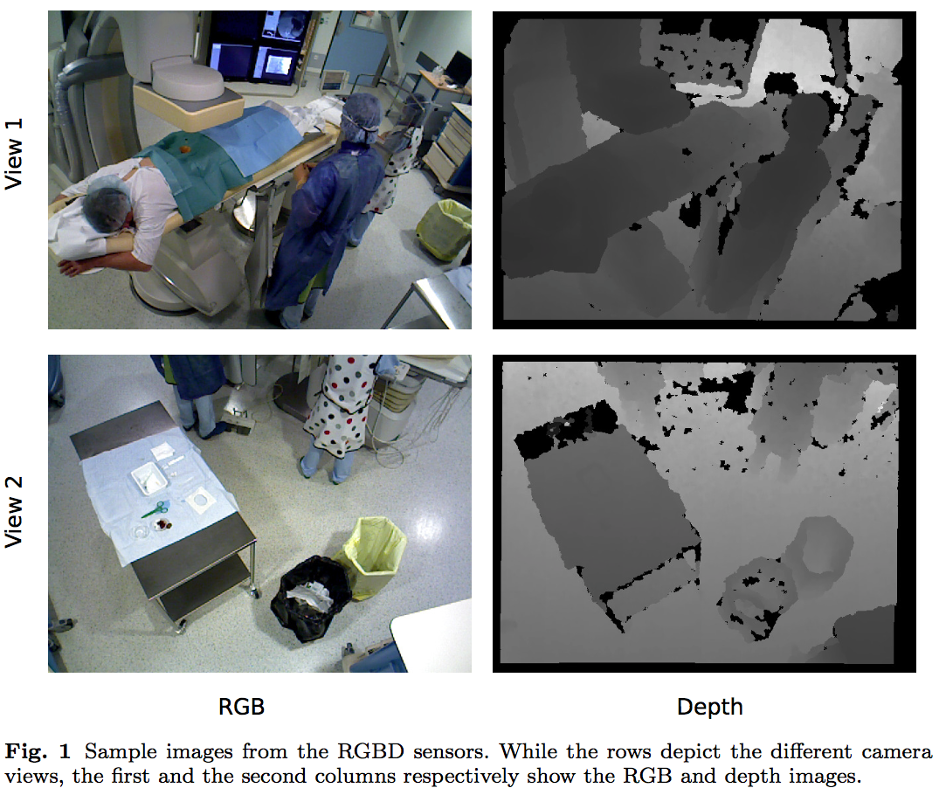
Related Work
Data-driven spatio-temporal RGBD feature encoding for action recognition in operating rooms [2]
[2] Andru P. Twinanda, Emre O. Alkan, Afshin Gangi, Michel de Mathelin, Nicolas Padoy. Data-driven spatio-temporal RGBD feature encoding for action recognition in operating rooms. International Journal of Computer Assisted Radiology and Surgery, 2015
Notes:
This is from our team, provides foundation of the current work and we adopt their part of the pipeline and introduce voting scheme to address the similar problem.
We using the same dataset – 2 views, both intensity and depth videos, as you can see the operating rooms in not an easy environment, it has shiny objects, cluttered envorinment, many medical personal, little bit pattern interference because of overlapping view of RGBD cameras.

Slide 7
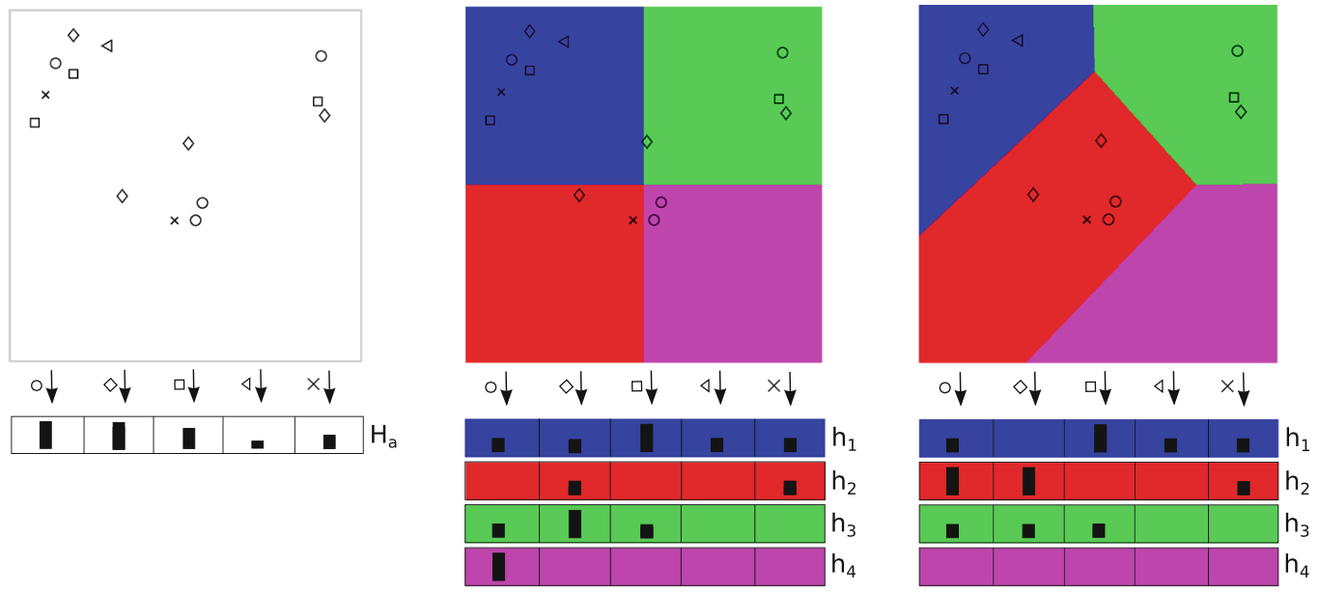
Related Work
Data-driven spatio-temporal RGBD feature encoding for action recognition in operating rooms [2]
[2] Andru P. Twinanda, Emre O. Alkan, Afshin Gangi, Michel de Mathelin, Nicolas Padoy. Data-driven spatio-temporal RGBD feature encoding for action recognition in operating rooms. International Journal of Computer Assisted Radiology and Surgery, 2015
Notes:
Image1: Classic BoW approach some information lost during the encoding process such as spatial and temporal information due to orderless nature of BoW, one dictionary is learnt to encode a feature vector
Image2: Lazebnik. Spatial Pyramid Matching. Just dividing without caring, but things may fall into one.
Image3: Combines the idea of voting with non-rigid layout – forms a base method for our voting scheme but image in spatial layout
learn the layout from the actual 4D spatio- temporal locations of the visual features. This results in a data-driven and non-rigid layout which retains more spatio-temporal information compared to the rigid counterpart. So this paper argues that you can retain more information

Slide 8
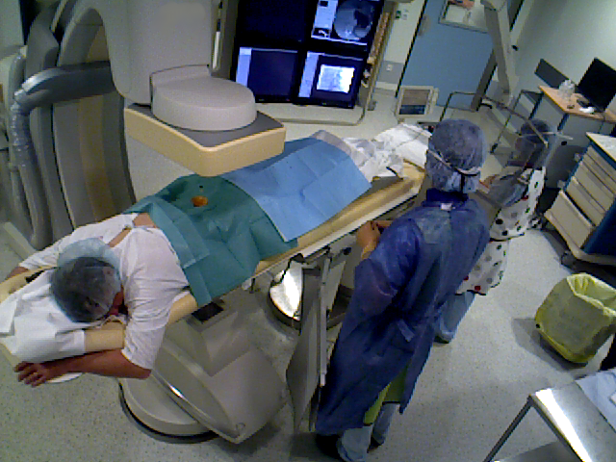
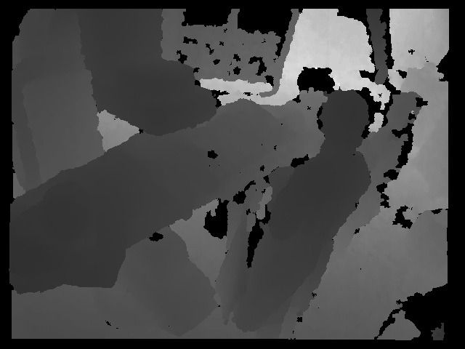
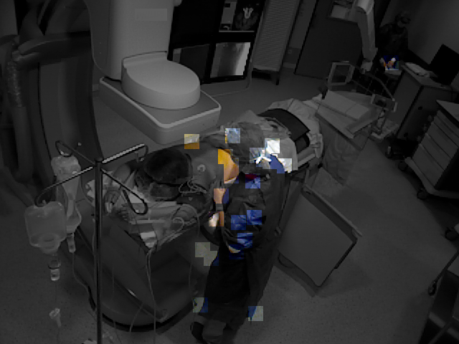
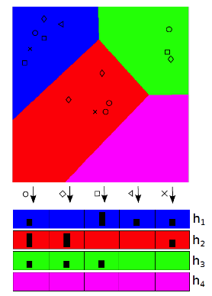
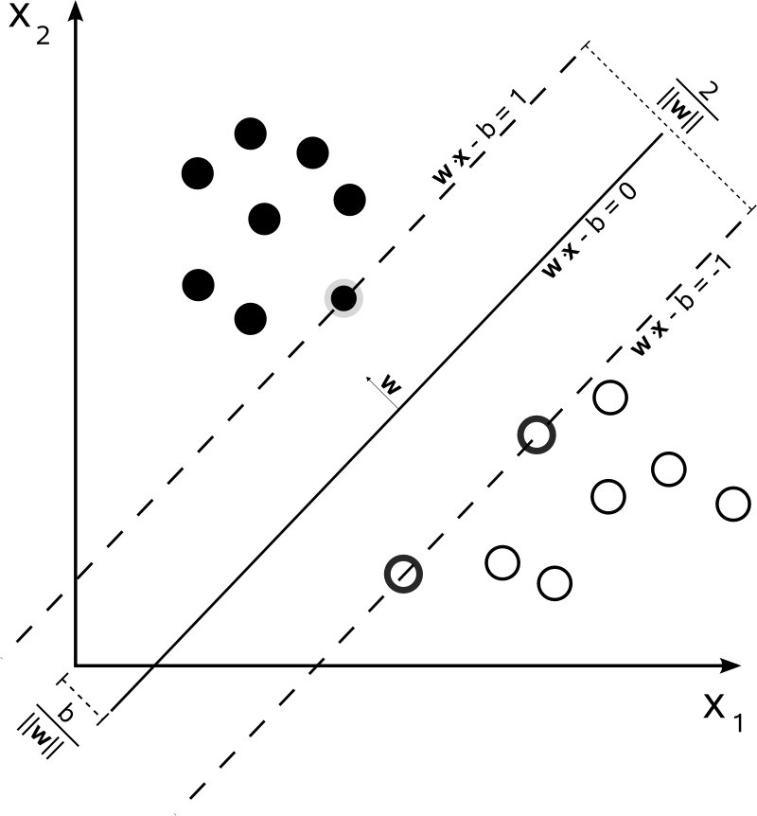
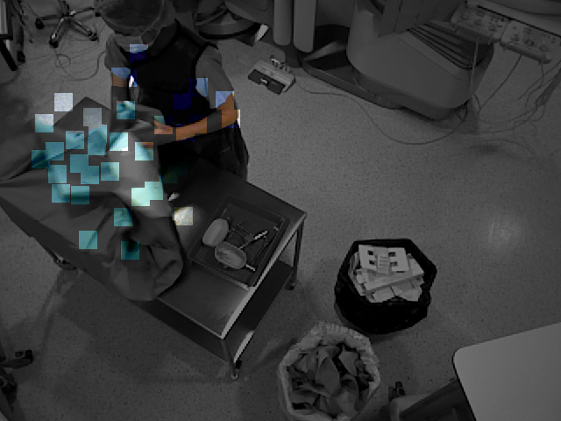
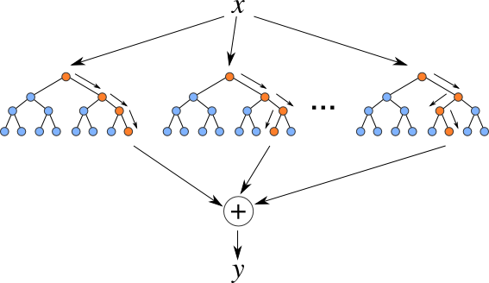
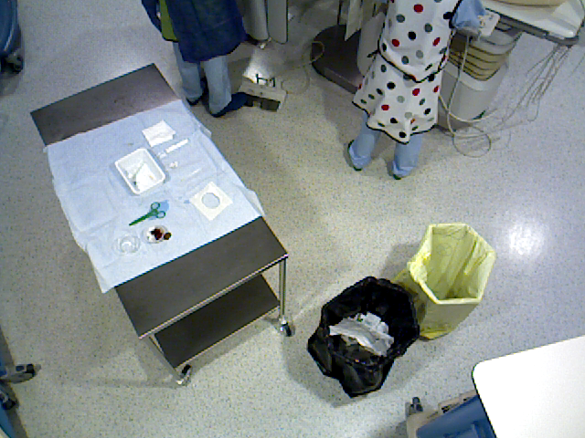
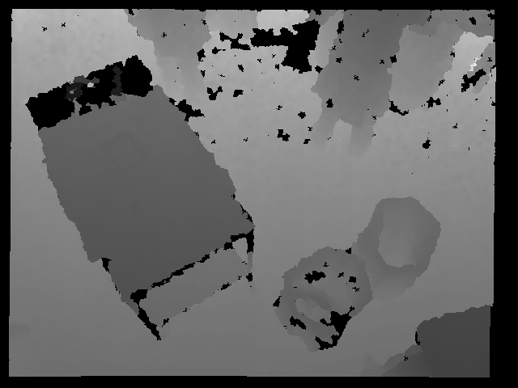
Methodology
View 1
Feature Extraction
Feature Quantization
Classification
RGB-D sequences
View 2
SVM and Random Forest
Activity Classification Pipeline
Notes:
Our activitiy classification pipeline starts with VIDEO ACQUISITION

Slide 9
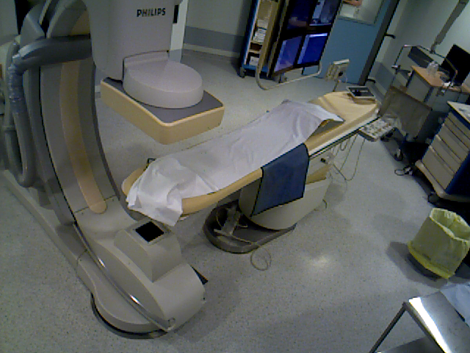
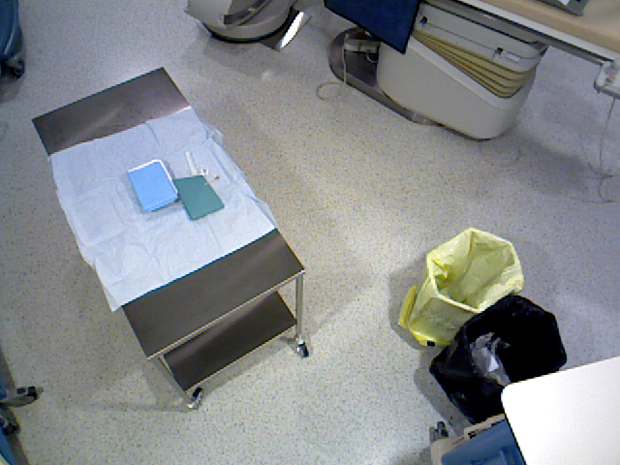
Video Acquisition
Multi-View Camera System (2 x Asus XtionPRO LIVE)
Two camera view provides intensity and depth videos
Minimal IR pattern interference with minimal view overlap
Intrinsic parameters are found with chessboard calibration
Extrinsic parameters are found with laser calibration [3]
View 1
View 2
[3] Barrera F, Padoy N (2014) Piecewise planar decomposition of 3d point clouds obtained from multiple static RGB-D cameras. In: International conference on 3D vision (3DV)
Notes:
We have 2 cameras mounted onto the ceiling of the operating room. One is covering the operating room bed area, on the other hand, other camera viewing the tool table area. Thanks to minimal overlap of the views, there is less IR pattern interference since depth cameras are using invisible structured lights to reconstruct the scene.

Slide 10
Methodology
View 1
Feature Extraction
Feature Quantization
Classification
RGB-D sequences
View 2
SVM and Random Forest
Activity Classification Pipeline
Notes:
Our second step is feature extraction from intensity and depth images

Slide 11
Feature Extraction
Intensity
Spatio-Temporal Interest Point (STIP) [4]
Extension of harris corner detection to spatio-temporal domain
Peaks and large variations in intensity in spatial and temporal domain
Histogram of optical flow (HOF)
Depth
Depth Spatio-Temporal Interest Point (D-STIP) [5]
Similar with STIP, noise suppression introduced for noisy depth images
Depth Cuboid Similarity Feature (DCSF): self similarity descriptor
[4] Piotr Dollar, Vincent Rabaud, Garrison Cottrell, and Serge Belongie. Behavior recognition via sparse spatio-temporal features. In VS-PETS, October 2005.
[5] Lu Xia and J.K. Aggarwal. Spatio-temporal depth cuboid similarity feature for activity recognition using depth camera. In CVPR, 2013.
Notes:
We use STIP which is spatio-temporal interest points detected in spatio-temporal domain. STIPs are extension of harris corner detection to spatio-temporal domain. They are detected in spatial and temporal doamin very high variations. Then we extract Histogram of Optical Flows. The reason we extract HOF is we have some similar activities with different motion direction like bed enters room and bed leaves the room.
For depth videos we detect DSTIPs which are same as STIP there is only some filtering introduced due to nature of the depth data. Xia et al. also introduce a feature called DCSF for depth images, which is self similarity descriptor. It’s put cuboid around DSTIP and divide it into smaller cuboids and calculate similarity between each cuboid using Bhattacharyya distance

Slide 12
Methodology
View 1
Feature Extraction
Feature Quantization
Classification
RGB-D sequences
View 2
SVM and Random Forest
Activity Classification Pipeline
Notes:
Our third step is feature quantization. Thanks to this step we enable the voting scheme.

Slide 13
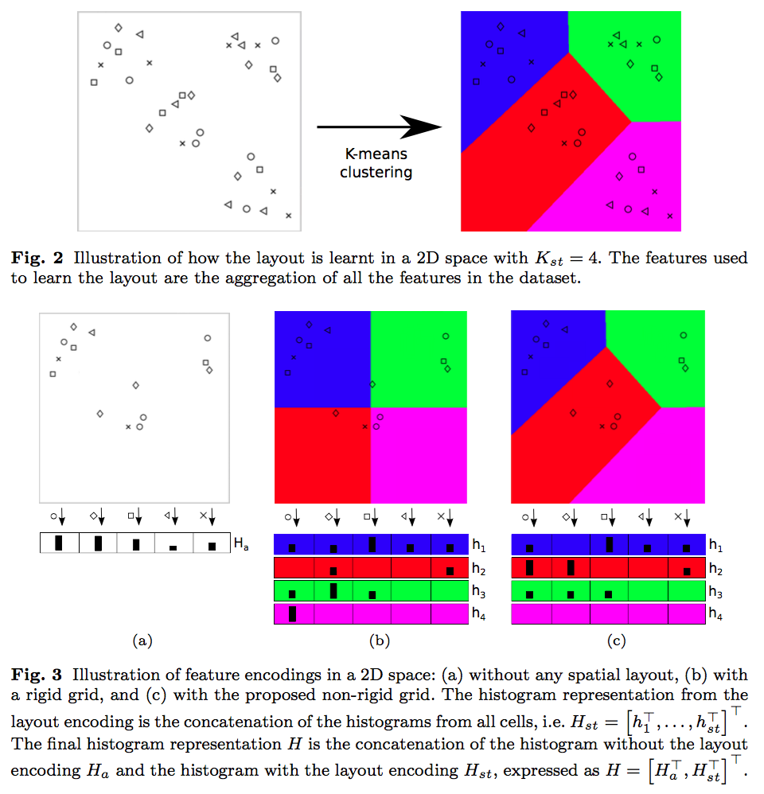
Voting Scheme & Feature Quantization
[2]
[2] Andru P. Twinanda, Emre O. Alkan, Afshin Gangi, Michel de Mathelin, Nicolas Padoy. Data-driven spatio-temporal RGBD feature encoding for action recognition in operating rooms. International Journal of Computer Assisted Radiology and Surgery, 2015
Notes:
Separate dictionaries: a visual dictionary and spatio-temporal dictionary
Visual dictionary: used to encode visual features(HOF/DCSF)
Spatio-temporal dictionary: used in place of a rigid-grid that divides spatio-temporal space
Our voting scheme idea is coming from the feature quantization and encoding idea from the Twinanda et al.
In their work, they concatenate feature vectors from the layout patches with non-layout. However we think that each patch is from 4D space and carry informative information – so we use each patch separately for voting for an activity.

Slide 14
Methodology
View 1
Feature Extraction
Feature Quantization
Classification
RGB-D sequences
View 2
SVM and Random Forest
Activity Classification Pipeline
Notes:
Our last step in the methodology part is classification. Here we introduce two-level classification model.

Slide 15
Classification
Two-level classification
1st Level: Learning probability votes
2nd Level: Learning weights of the patch
Two different classification approach in the 1st Level
One-model approach
Multi-model approach
Notes:
We introduce two level classification in order to recognize activities.
In the first level we learn the probability votes. We call probability votes because after 1st level classification we get feature vectors consist of probabilities of the classes of a patch
Then we use 2nd level classifier to get the weight which is our final probability vector for activity classification.

Slide 16
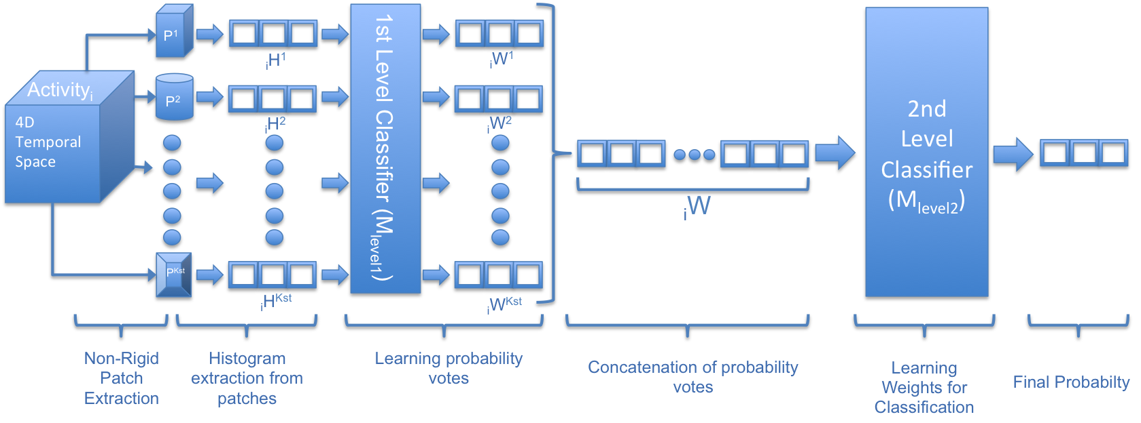
Classification
One-model approach

Slide 17
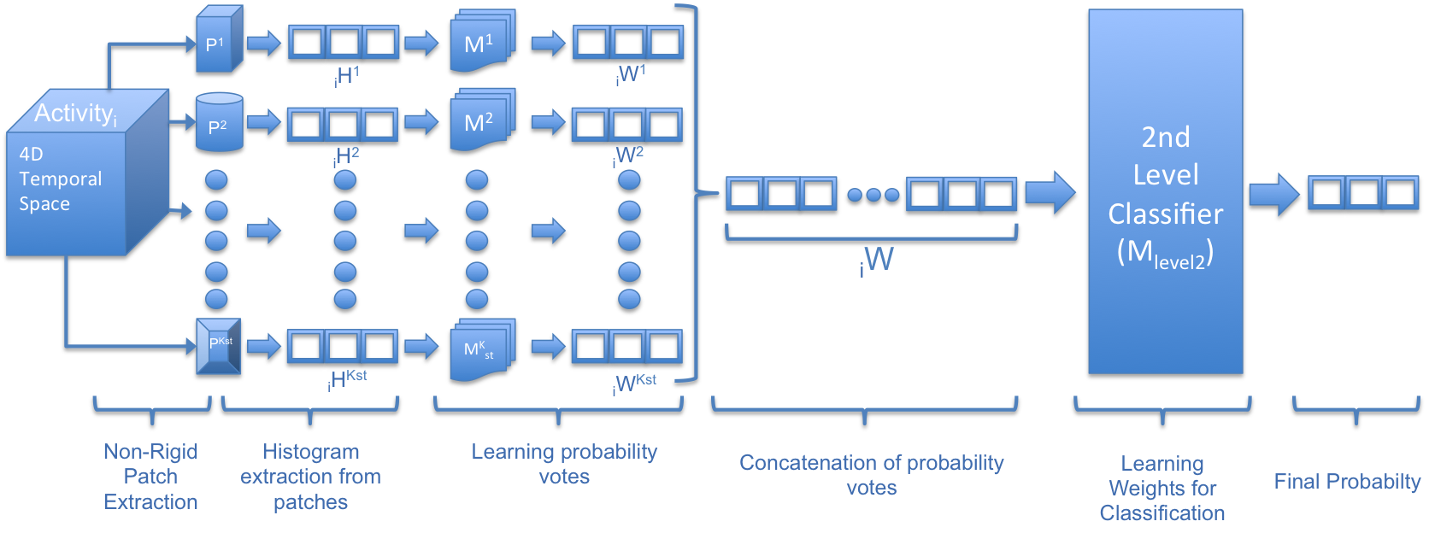
Classification
Multi-model approach

Slide 18
Experimental Setup
Dataset [2]
11-day recordings of OR recording
Total of 1734 video clips of 15 actions
View 1
View 2
[2] Andru P. Twinanda, Emre O. Alkan, Afshin Gangi, Michel de Mathelin, Nicolas Padoy. Data-driven spatio-temporal RGBD feature encoding for action recognition in operating rooms. International Journal of Computer Assisted Radiology and Surgery, 2015
Notes:
While one of the camera is capturing the area around the operating room bed, the other camera captures the area with equipment table, in which large area of the operating rooms is covered. The dataset is really hard, many clutter, shiny objects, dynamic environment, many clinic personal during operation, they wear same clothes, its very dense environment.

Slide 19
Experimental Setup
Notes:
You can see imbalance of the data. To overcome that we using bagging on training to avoid being bias. For example maximum number of instance is in Adjusting C-Arm where robotics c-arm is turning in order to take x-rays. Where as we have 28 instance from mixing cement which is very less and hard to deal.

Slide 20
Experimental Results
One-model approach
Multi-model approach
 | SVM | RF
Intensity | 74.45% | 70.06%
Depth | 72.72% | 67.87%
Combination | 83.1% | 79.18%
 | SVM | RF
Intensity | 77.28% | 69.20%
Depth | 71.91% | 64.45%
Combination | 81.71% | 75.54%
Notes:
One-model approach have slightly higher accuracy than multi-model approach. We’ve seen that in multi-model approach, in first level classification, each model sees less data the one-model approach, this is, in our case, we have 15 class, so one-model approach in first level classifier sees 15 times more data than multi-model approach.

Slide 21
Experimental Results
One-model voting scheme vs non-voting [2]
 | Non-voting [2] | Voting
SVM | 85.53% | 81.71%
RF | 76.87% | 75.54%
[2] Andru P. Twinanda, Emre O. Alkan, Afshin Gangi, Michel de Mathelin, Nicolas Padoy. Data-driven spatio-temporal RGBD feature encoding for action recognition in operating rooms. International Journal of Computer Assisted Radiology and Surgery, 2015

Slide 22
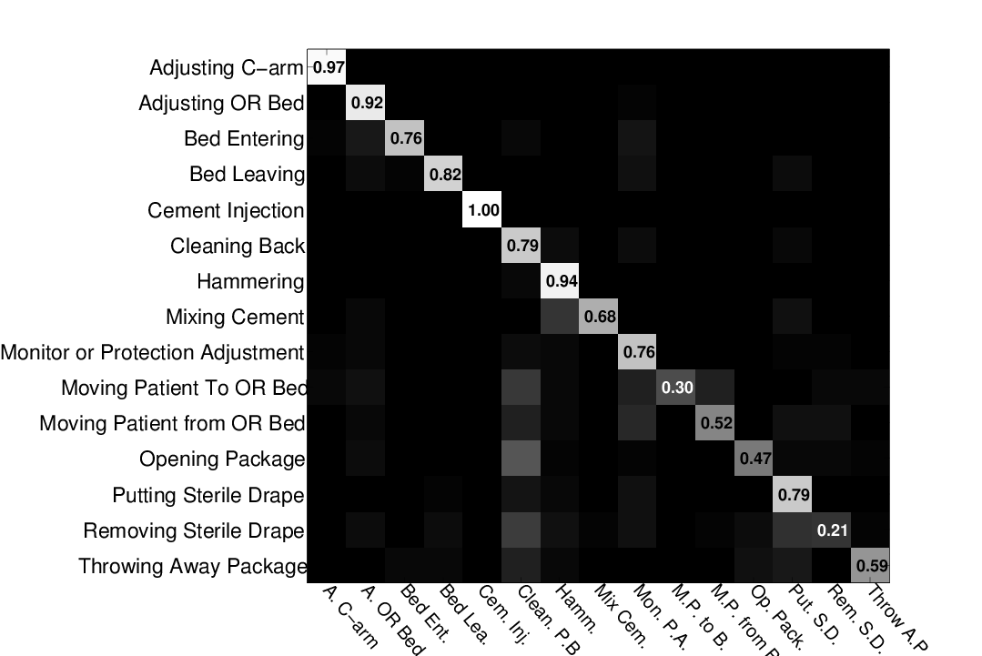
Experimental Results
Confusion Matrix

Slide 23
Conclusions
The problem of action recognition in an operating room using voting scheme was addressed
The data-driven non-rigid 4D spatio-temporal patches are informative for activity recognition
Because it sees more data, the one-model approach performs better than the multi-model approach
Despite yielding slightly lower accuracy, the voting scheme shows promising results with 83.1% accuracy
Notes:
So non-voting scheme outperforms voting scheme in our data
We even tried with lower dimension like 100 for Intensity, it still didn’t give much only 69, so features are also lossy
Random Forest is very sensible to high dimensionality and
Two-level classification is required to learn patch weights and their contribution

Slide 24
Future Works
The current interest point detection is based on movements, sparse and ignores stationary parts
Dense interest points
Occupancy grid
BoW approach encodes features into sparse representation
Learning mid-level features
It would be interesting to incorporate the voting scheme for concurrent activity recognition
Notes:
STIP is sparse and only detecting movements. We want to use more dense detected interest points or sampling.
Learning mid level: new trend, Currently we directly encoding low level features with classic BoW and non-rigid layout
We also want to apply voting scheme to detect concurrent activities, thanks to patches from space, we can get votes for different activities

Slide 25



Thank you
Questions?
Acknowledgments
Research Group CAMMA , ICube, University of Strasbourg
http://camma.u-strasbg.fr

